Slide 1
Earthquakes in Turkey
Başak Dilara Çevik

Slide 2
Contents
1-) Introduction
2-) Earthquake Risk in Turkey
3-) Data Sources and Collection
4-) Project Goal
5-) Analysis and Metrics
6-) Results and Implications
7-) Conclusion and Future Work
8-) Q&A

Slide 3


Introduction
This data science project focuses on researching earthquakes in towns of Turkey based on population and magnitude frequency.
The project aims to identify areas that are most vulnerable to seismic events by using data from various sources, including the United States Geological Survey and the Turkish Statistical Institute.
Through analysis of earthquake frequency and population density, a new metric was created to help identify towns that are most at risk.
The project provides valuable insights for government agencies responsible for disaster management, non-governmental organizations, and researchers studying earthquake risk in Turkey.

Slide 4
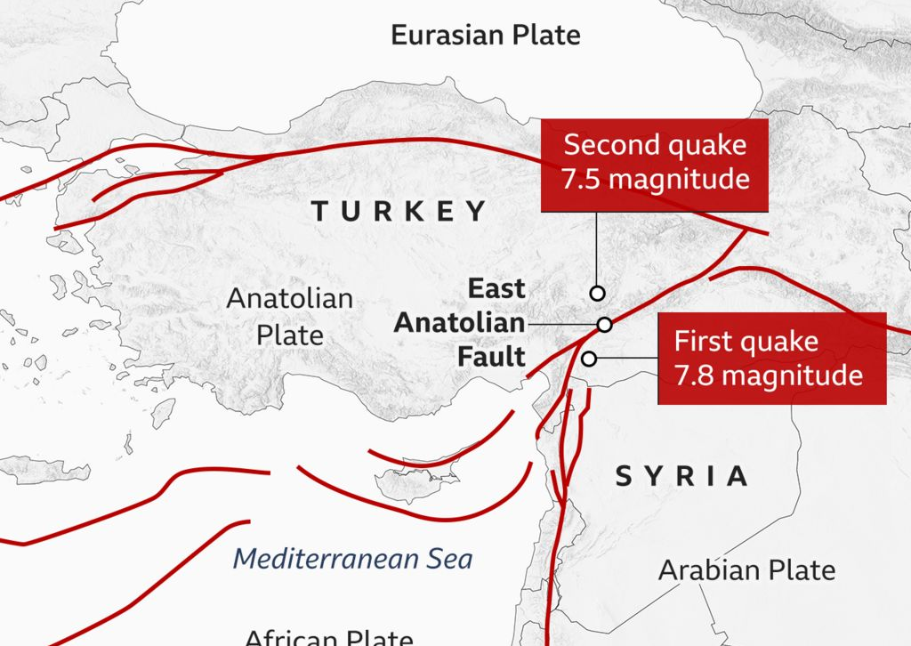
Earthquake Risk in Turkey
Earthquake risk in Turkey is a serious concern due to the country's location on the Mediterranean and Eurasian tectonic plates, which causes frequent seismic activity. This data science project aims to identify the towns in Turkey that are most at risk based on their population and the frequency of earthquakes in the region.

Slide 5

Data Sources and Collection
This data science project collects earthquake data from the United States Geological Survey (USGS) database, which maintains records of all earthquakes worldwide with a magnitude of 2.5 or higher since 1903, including those in Turkey. The project also utilizes population data for each town in Turkey from the Turkish Statistical Institute (TÜİK). The earthquake and population data were collected, cleaned, and preprocessed to create a dataset that could be used for analysis.

Slide 6

Project Goal
The main goal of this data science project is to provide insights into the earthquake risk in different parts of Turkey and identify the towns that are most vulnerable to seismic events. By analyzing earthquake and population data, the project aims to create a new metric that can help identify the areas that are most at risk. The results of this project can be used by government agencies responsible for disaster management and urban planning, as well as NGOs (Non-Governmental Organization) and researchers studying earthquake risk in Turkey.

Slide 7
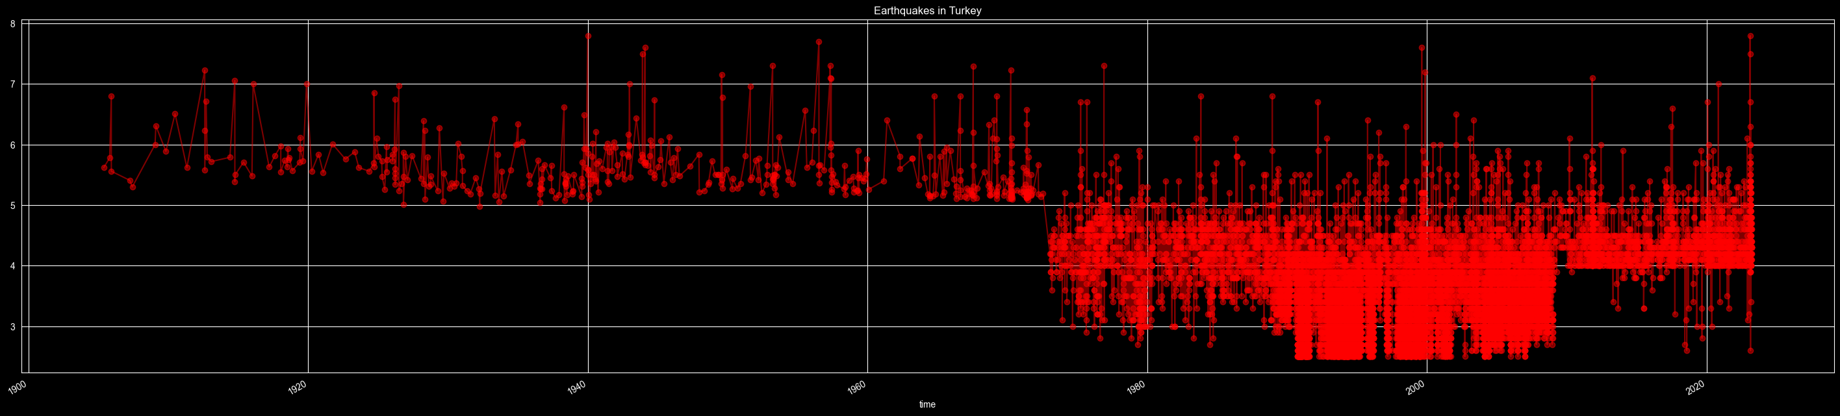
Earthquakes in Turkey (1903-2023)
Analysis and Metrics

Slide 8
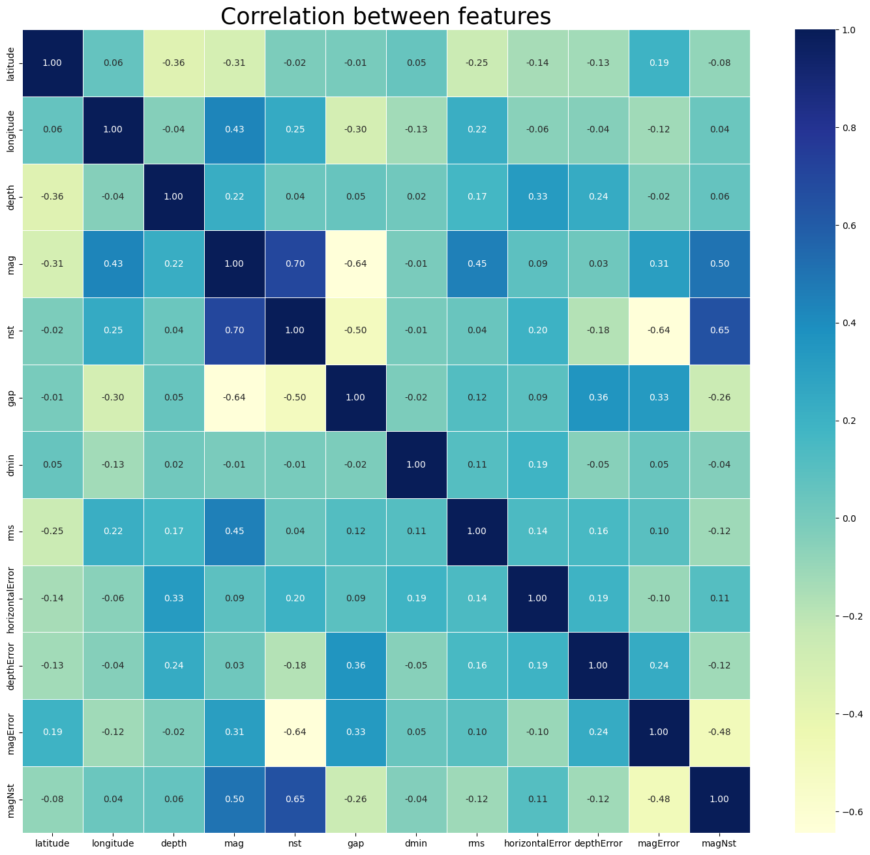
Correlation is a statistical measure that describes the relationship between two variables. It indicates the extent to which two variables are related to each other and in what way.

Slide 9
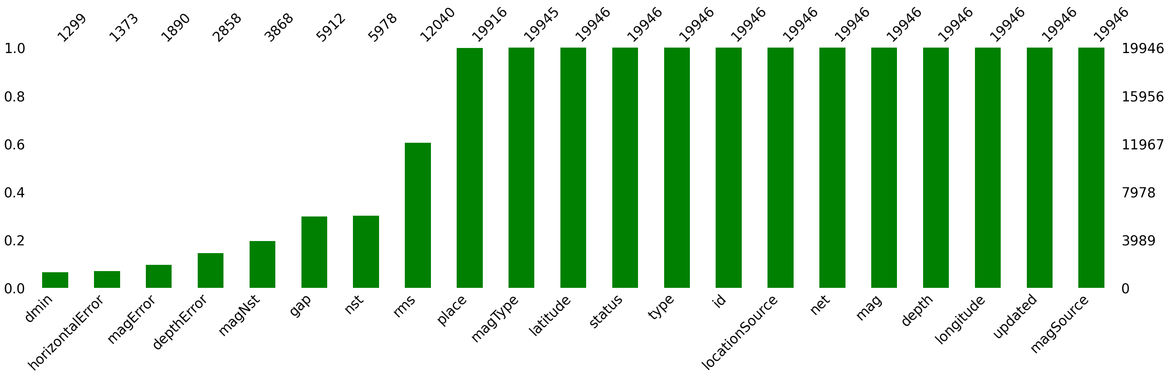
Missing Values:

Slide 10
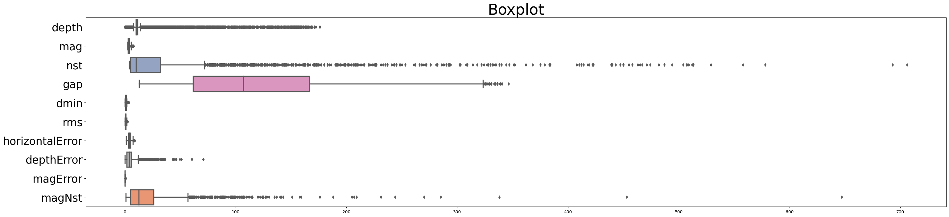
Outlier Detection:

Slide 11
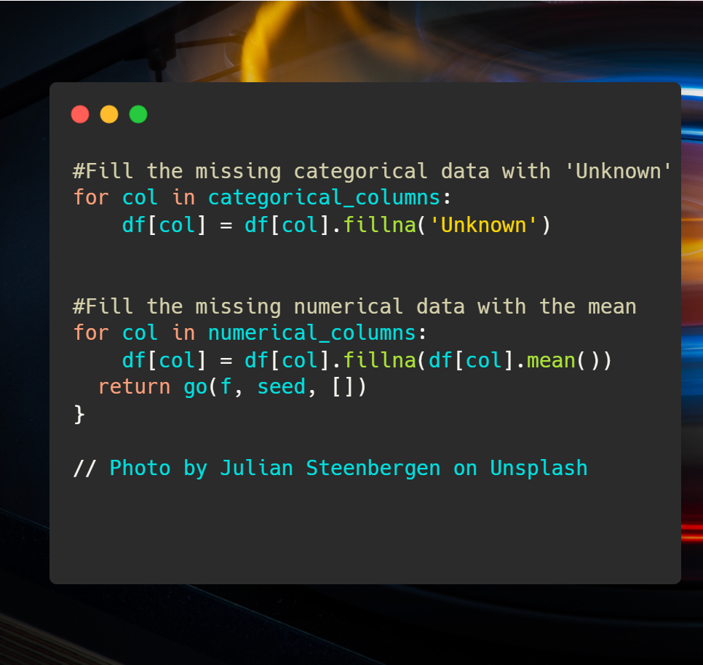
Problems with the data:
Missing values
Duplicate values
City and town names could be extracted from the place column

Slide 12
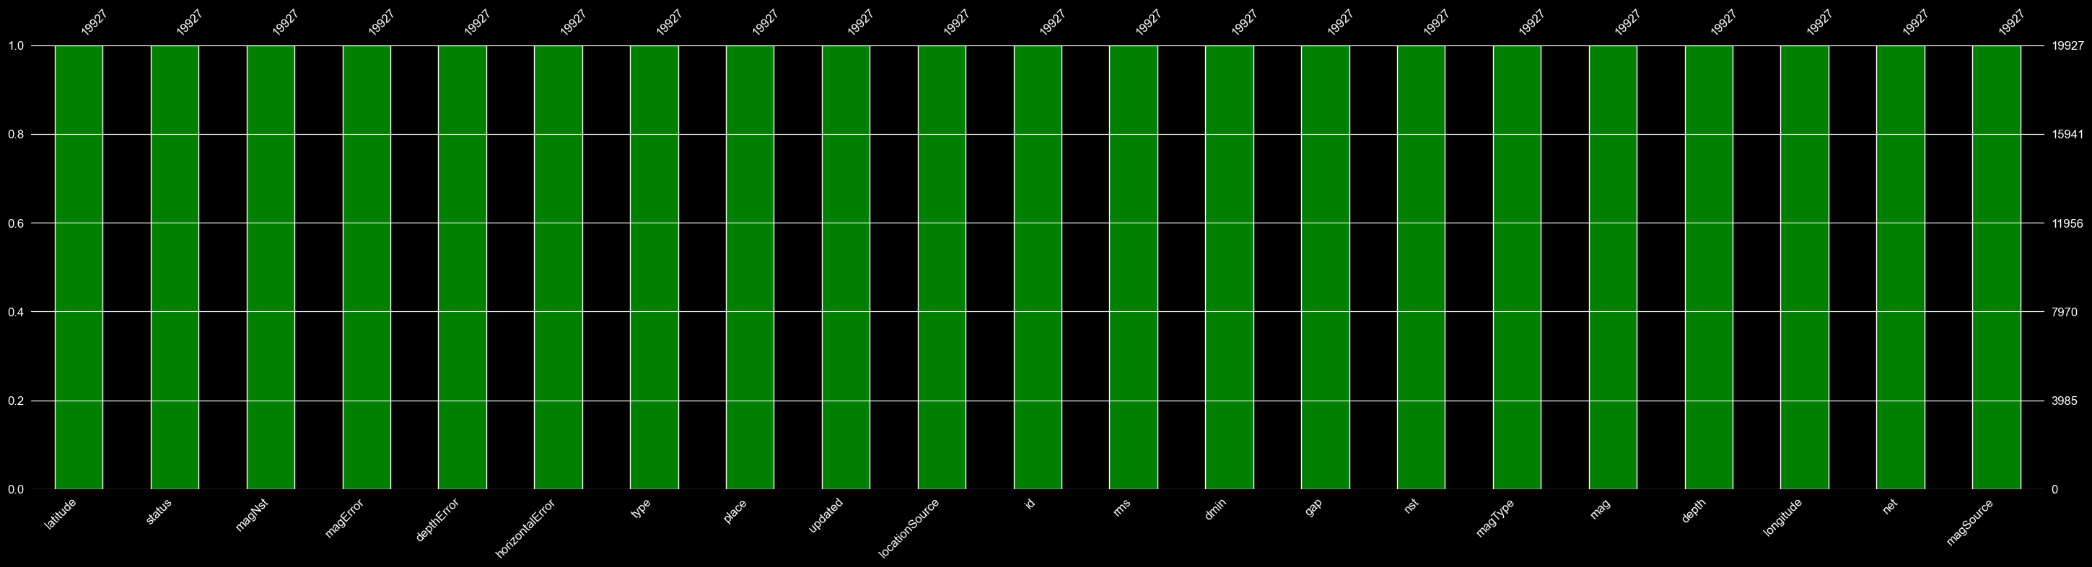
Check for Missing Values Again:

Slide 13
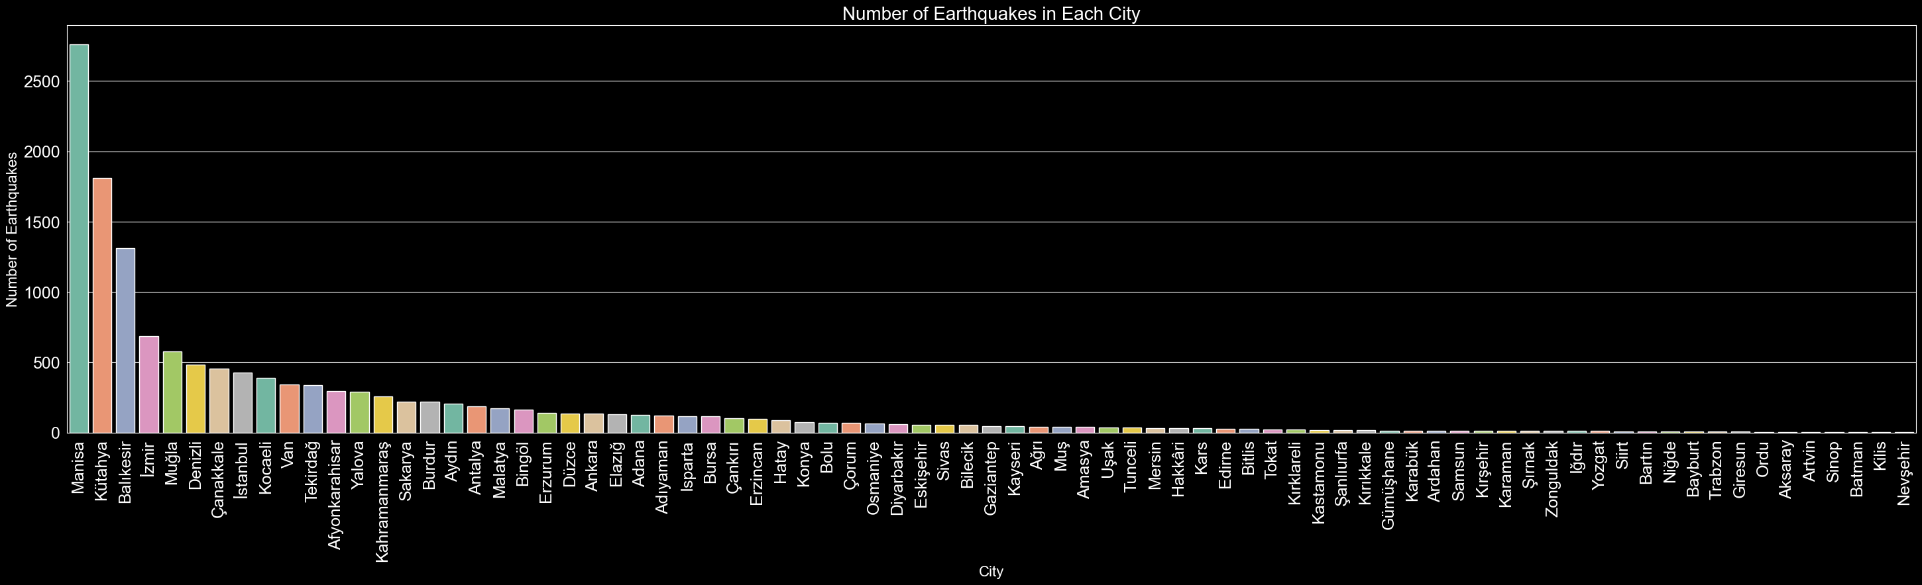
According to the Turkish Disaster and Emergency Management Presidency (AFAD), the cities with the highest number of earthquakes in Turkey are as follows: - Muğla - İzmir - Antalya However, according to earthquake data for the last 120 years, it can be seen that Manisa, Kütahya, and Balıkesir are among the top cities with the highest number of earthquakes in Turkey.

Slide 14
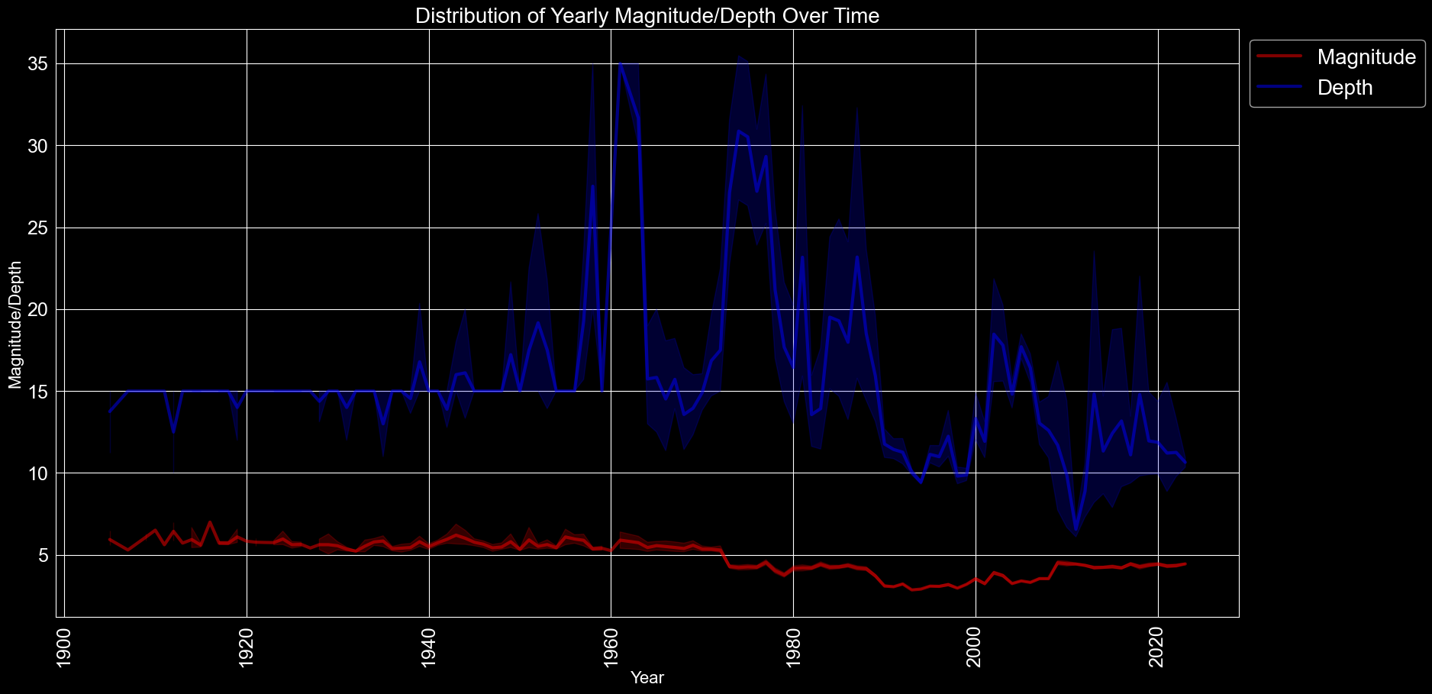
The shade around the line represents the confidence interval (CI) of the mean of the data at each x value. The default CI is 95%, which means that the shaded area represents the range within which we are 95% confident that the true mean of the data lies, based on the sample that we have. The width of the shaded area reflects the level of uncertainty in the estimate of the mean at each x value. If the shaded area is narrow, it indicates that there is low variability in the data, and we are relatively certain about the estimated mean. On the other hand, if the shaded area is wide, it suggests that there is high variability in the data, and we are less certain about the estimated mean.

Slide 15
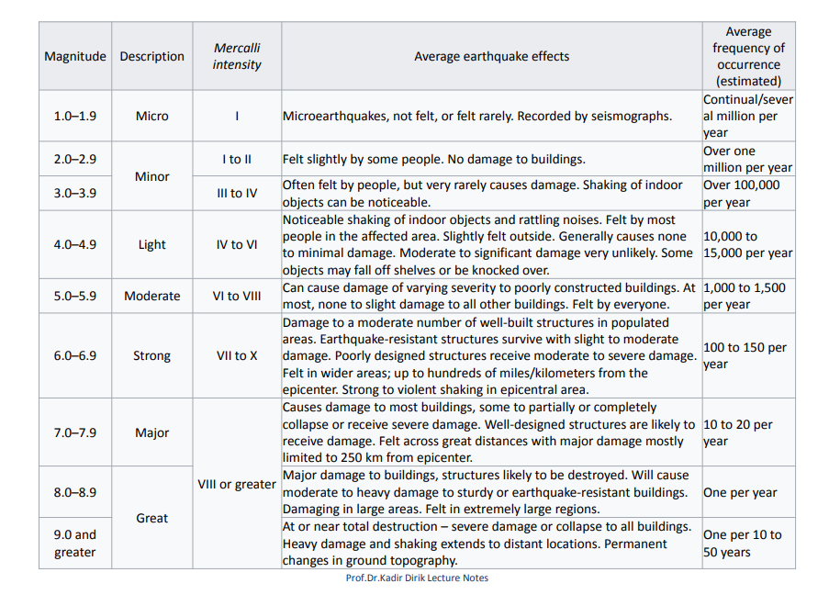
Comparing Earthquake Characteristics: A Table of Richter Scale, Mercalli Intensity, Effects, and Frequency

Slide 16
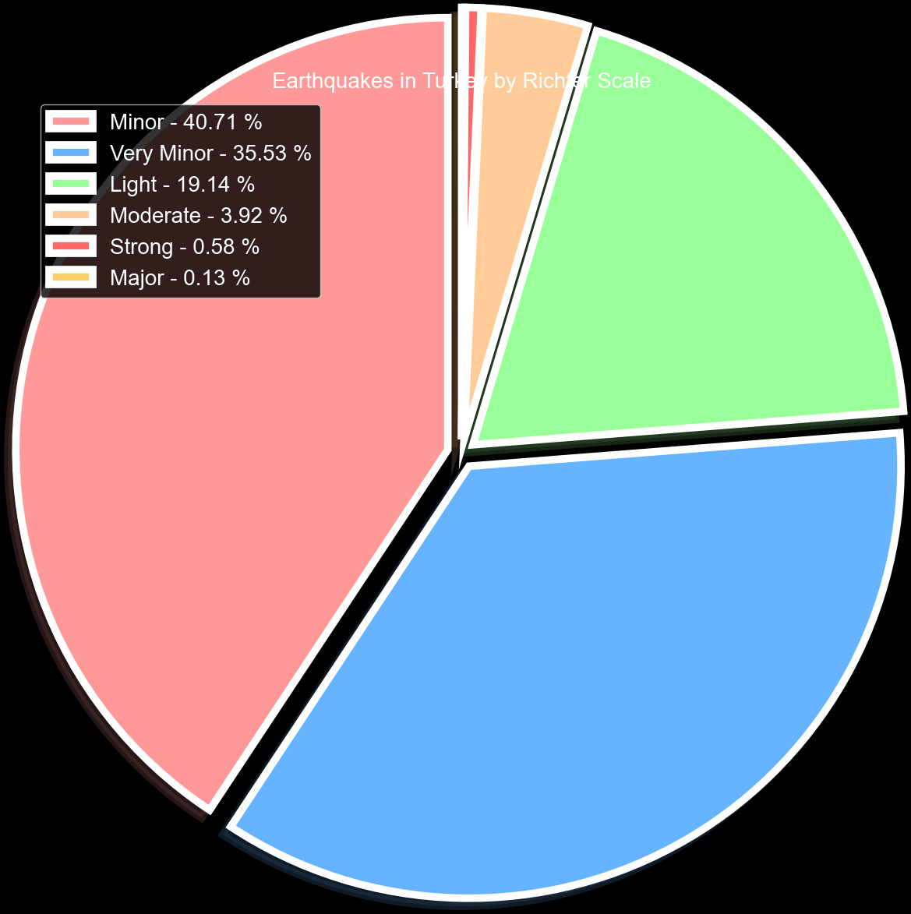
Richter Scale Pie Chart of Turkey's Earthquakes
According to the Richter scale, over the past 120 years in Turkey, approximately 85% of earthquakes have been categorized as either minor, very minor, or light, while 4% were considered moderate and only 0.71% were classified as strong or major earthquakes.

Slide 17
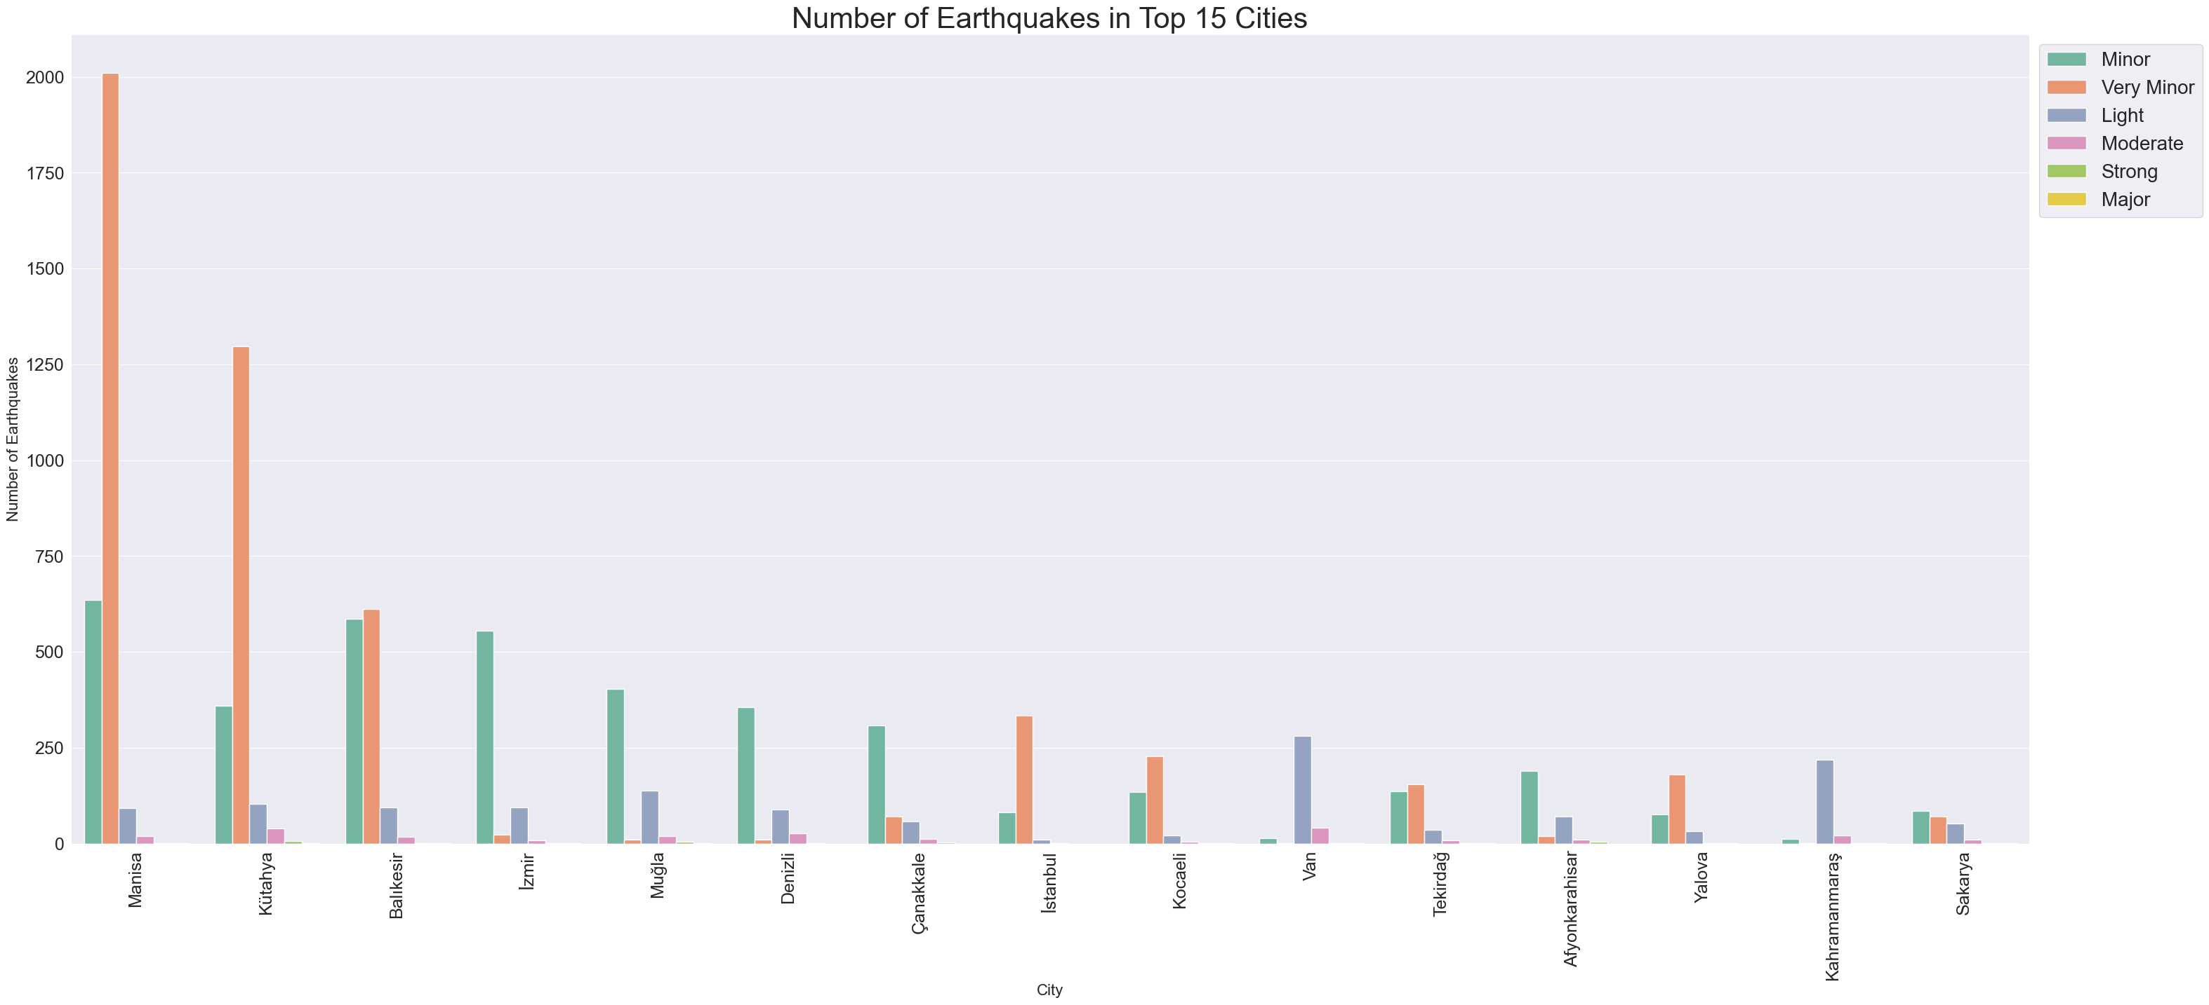
The most earthquake prone city in Turkey is Manisa with 2760 earthquakes.

Slide 18
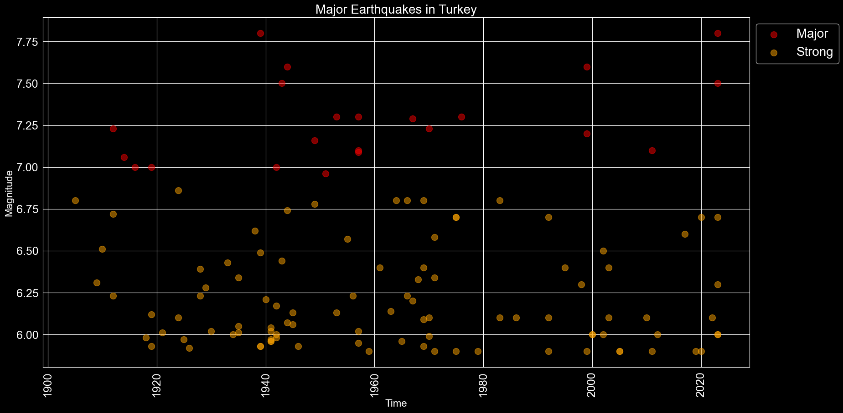
Major and Strong Earthquakes in Turkey
The distribution of strong and major earthquakes over the last 120 years is not evenly spread out. Turkey is located in a seismically active area and experiences a significant number of earthquakes each year, ranging from small tremors to major earthquakes.

Slide 19
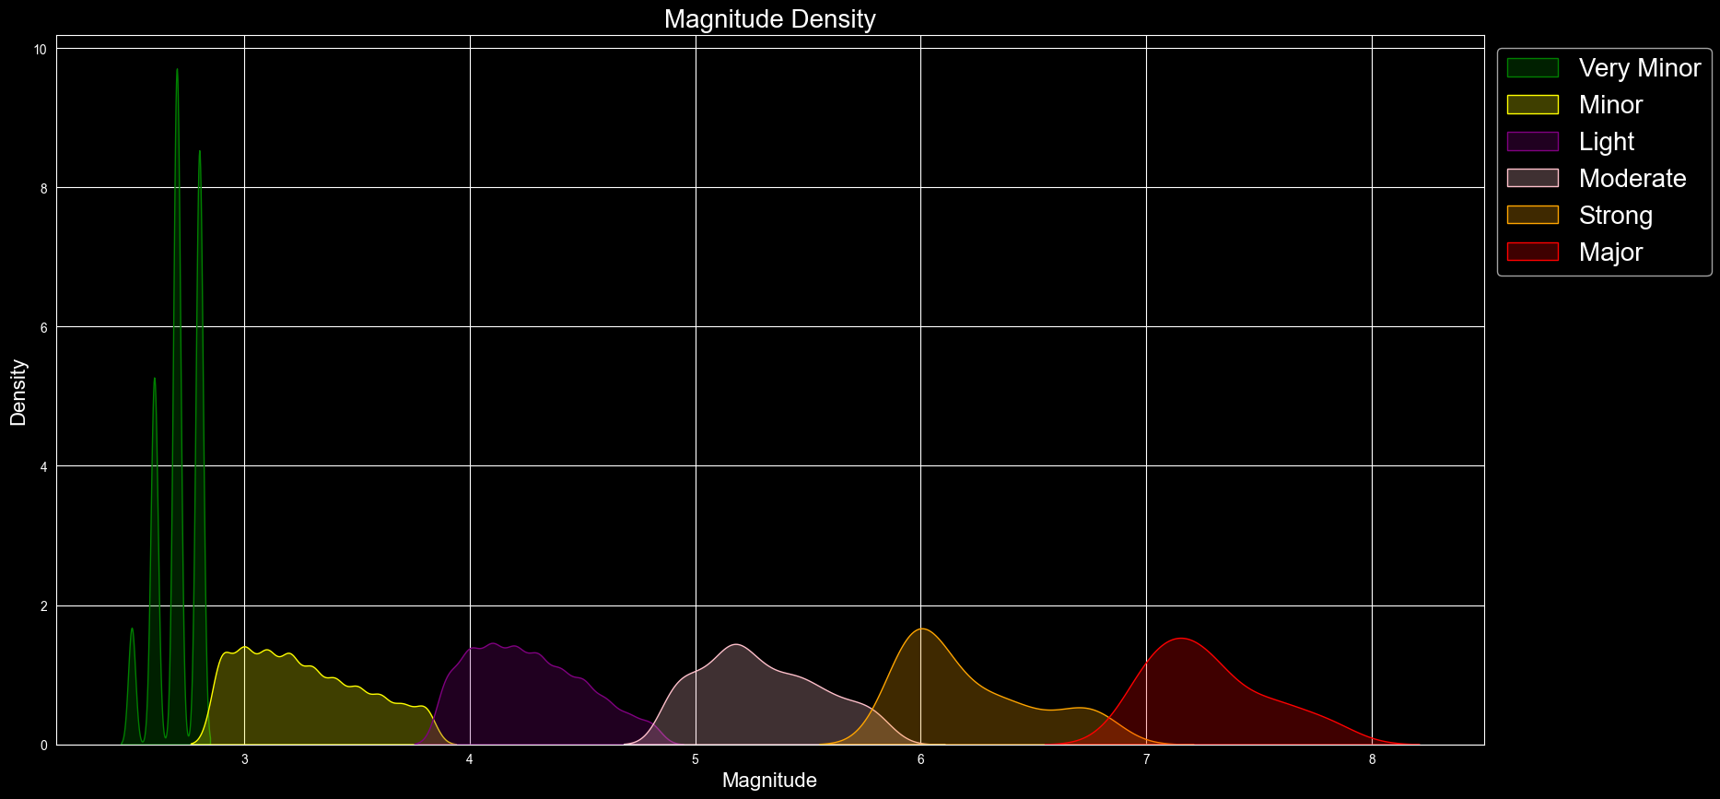
A KDE plot (Kernel Density Estimate plot) is a data visualization technique used to estimate the probability density function of a random variable. Probability density is a concept in probability theory that is used to describe the likelihood of a continuous random variable taking on a particular value. In other words, it's a way of characterizing the probability distribution of a continuous random variable.

Slide 20
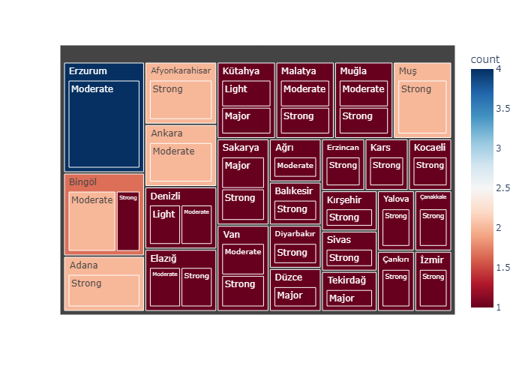
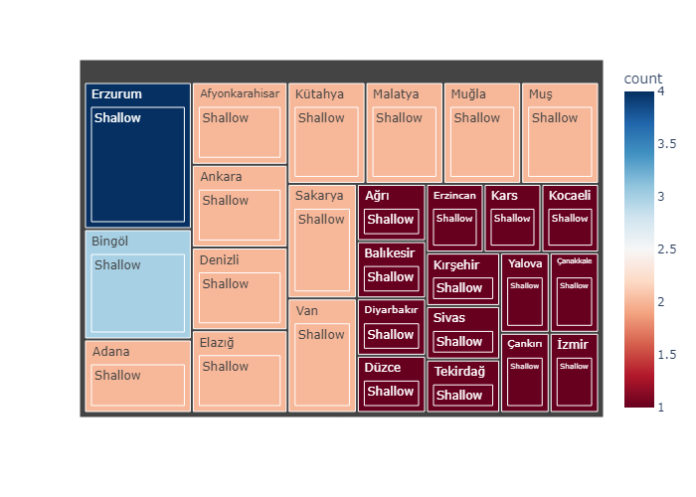
Exploring the Most Frequent Magnitude and Depth of Earthquakes Across Cities
In terms of earthquake frequency, Turkey typically experiences shallow-depth earthquakes with moderate to light magnitudes, as well as occasional strong earthquakes.

Slide 21
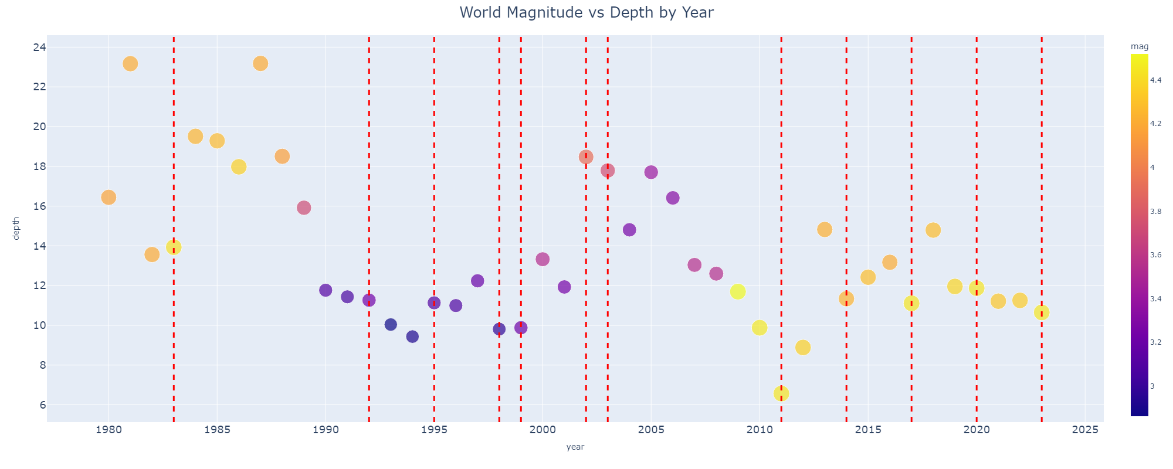
2020 Elazığ Earthquake
2023 Kahramanmaraş Earthquake
2023 Turkey–Syria earthquakes
2011 Van Earthquake
2014 Aegean Sea earthquake
2017 Aegean Sea earthquake
2020 İzmir Earthquake
1983 Erzurum earthquake
1992 Erzincan earthquake
1995 Dinar earthquake
1998 Adana–Ceyhan earthquake
1999 İzmit earthquake
1999 Düzce Earthquake
2002 Afyon earthquake
2003 Bingöl earthquake

Slide 22
A new variable called 'damage’ was created, which aims to measure the overall damage caused by an earthquake event. The variable is calculated by taking the logarithm of the product of the number of houses damaged and the total number of deaths resulting from the event.
The formula used for calculating the 'damage' variable is:
damage = log(Houses Damaged * Total Deaths)
Here, 'Houses Damaged' and 'Total Deaths' refer to the respective columns in the dataframe that contain the number of houses damaged and total deaths for each earthquake event. The logarithm function is applied to the product of these two columns to convert the resulting value to a logarithmic scale. This makes it easier to compare and analyze damage levels across different earthquake events, as the logarithmic scale allows for a wider range of values to be represented on a more manageable scale.
The resulting logarithmic value is added as a new column called 'damage' in the dataframe, allowing for easy access and analysis of the calculated values.

Slide 23
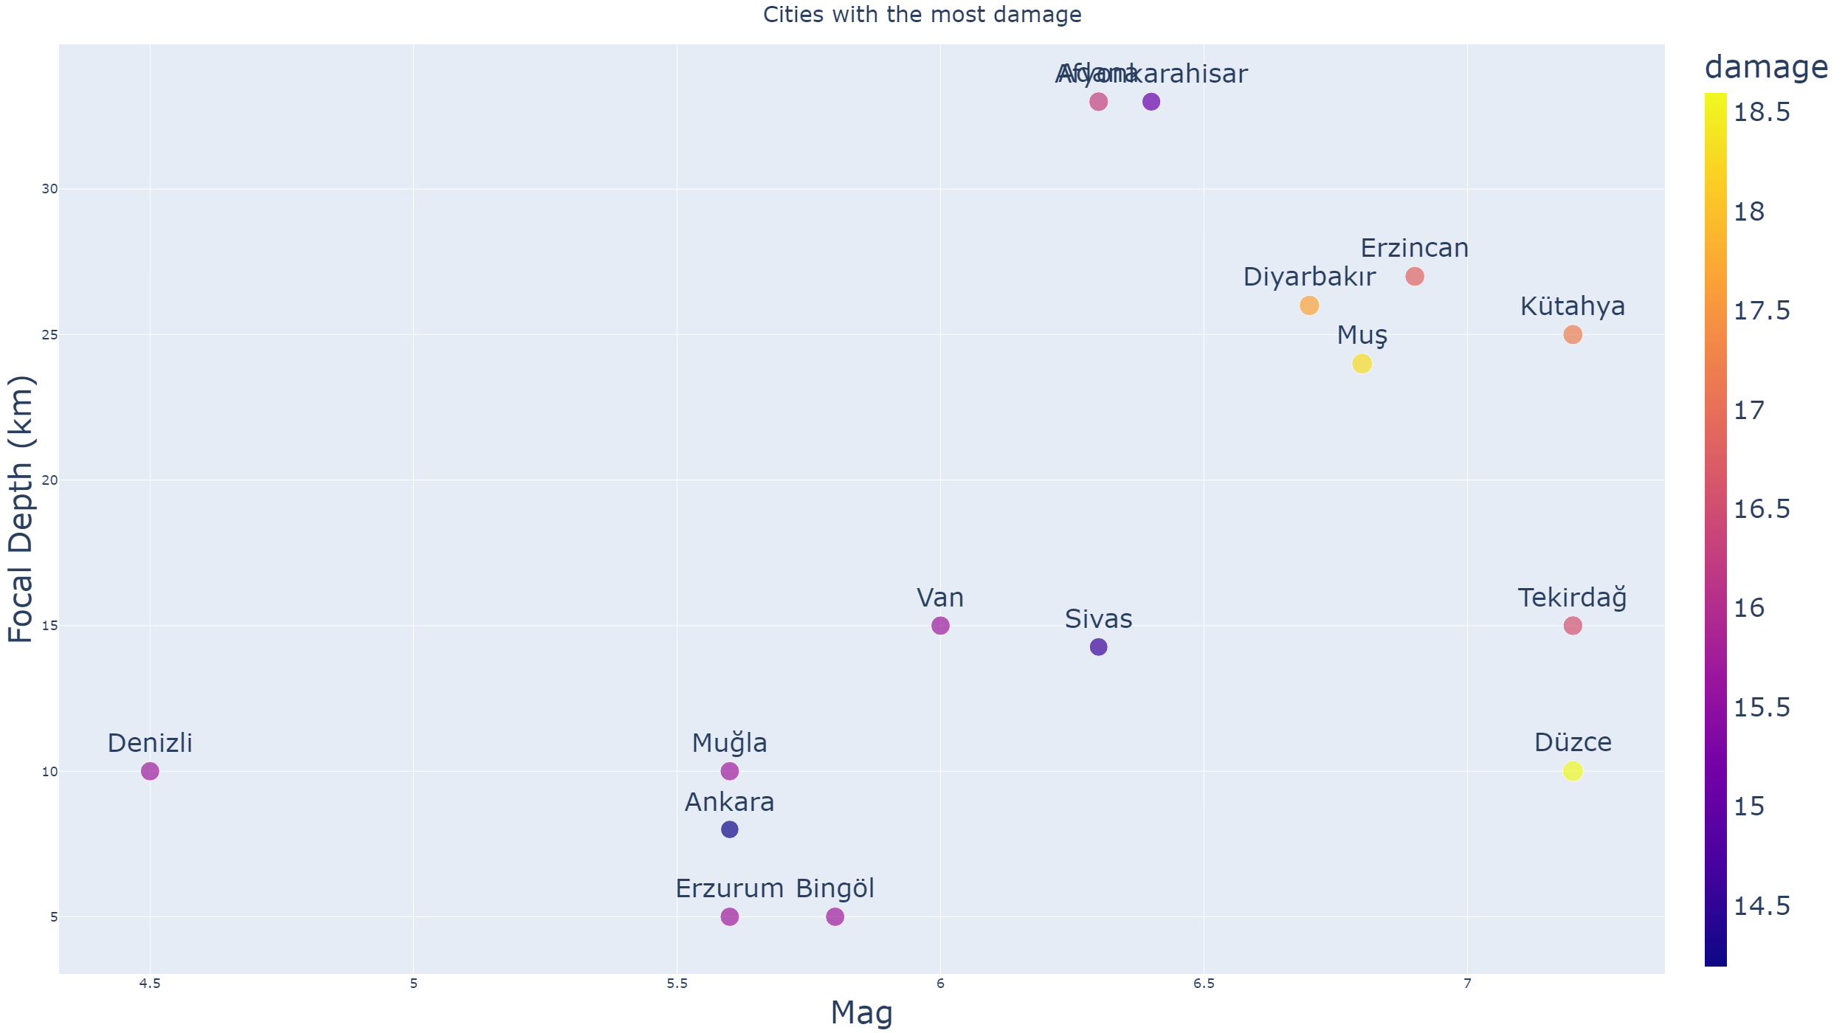
The graph depicts the relationship between the magnitude and depth of earthquakes and the amount of damage caused in various cities (as measured by a variable created later on). The graph indicates that, except for Adana and Afyonkarahisar, earthquakes with greater depths and magnitude levels tend to cause more damage than those with lower levels.

Slide 24
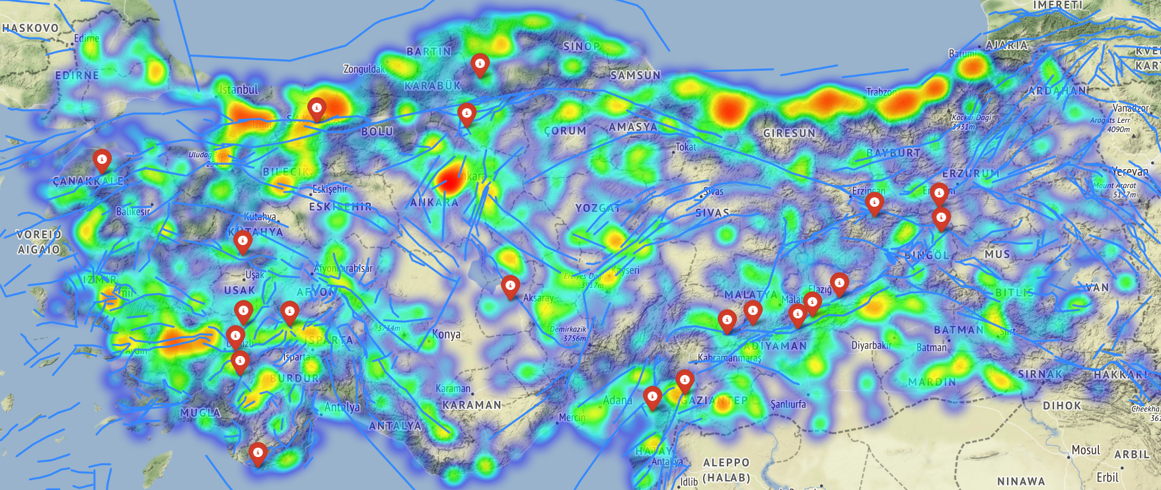
Population Density and Earthquake Frequency

Slide 25
$$Earthquake Importance Score = log10(Population of the affected area) ∗ (Magnitude of the earthquake)^2$$
Results and Implications
The population of the affected area is taken as the base-10 logarithm of the population. This is because the logarithmic scale compresses large numbers, making it easier to compare the relative sizes of populations. The logarithmic function also reduces the impact of outliers, such as extremely large or small populations.
The magnitude of the earthquake is squared to give it more weight in the calculation. This is because the energy released by an earthquake increases exponentially with the magnitude, so a larger magnitude earthquake can have a much greater impact than a smaller one.
By multiplying the logarithm of the population with the squared magnitude of the earthquake, this metric aims to capture both the number of people affected and the intensity of the earthquake.
The importance score is scaled between 0 and 10 to provide a standardized measure of significance for each factor being analyzed.

Slide 26
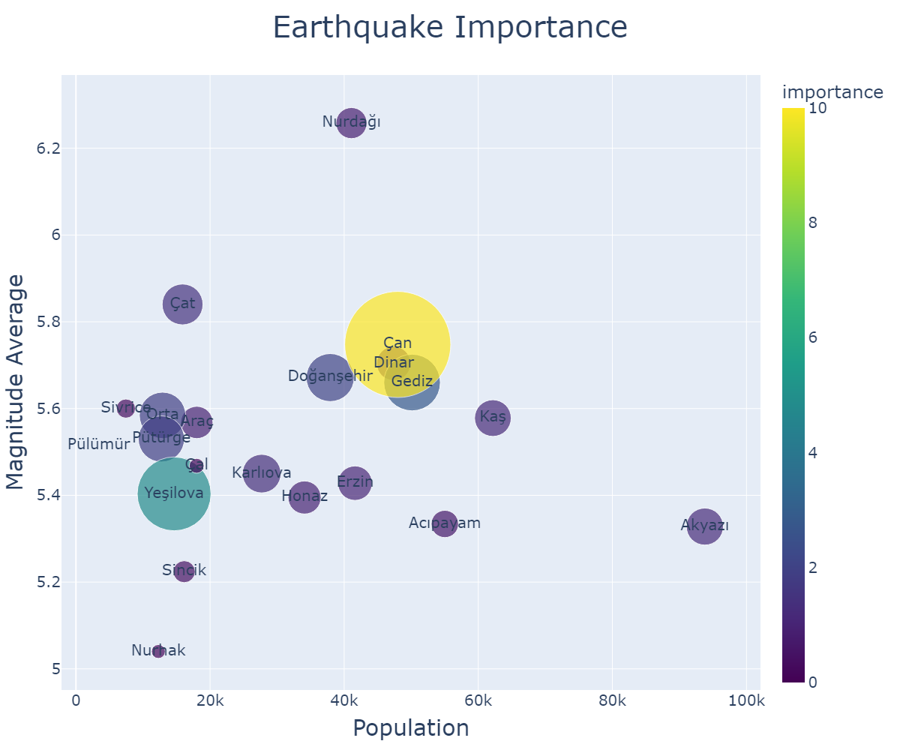
This metric can be used to explore the importance of earthquakes on a town-by-town basis, examining factors such as population and magnitude to gain a deeper understanding of how earthquakes affect different areas.
Town | City
Acıpayam | Denizli
Akyazı | Sakarya
Araç | Karabük
Dinar | Afyonkarahisar
Doğanşehir | Malatya
Erzin | Erzincan
Gediz | Kütahya
Honaz | Denizli
Karlıova | Muş
Kaş | Isparta
Nurdağı | Adana
Nurhak | Kahramanmaraş
Orta | Sivas
Pülümür | Tunceli
Pütürge | Malatya
Sincik | Adıyaman
Sivrice | Elazığ
Yeşilova | Burdur
Çal | Denizli
Çan | Çanakkale
Çat | Van

Slide 27
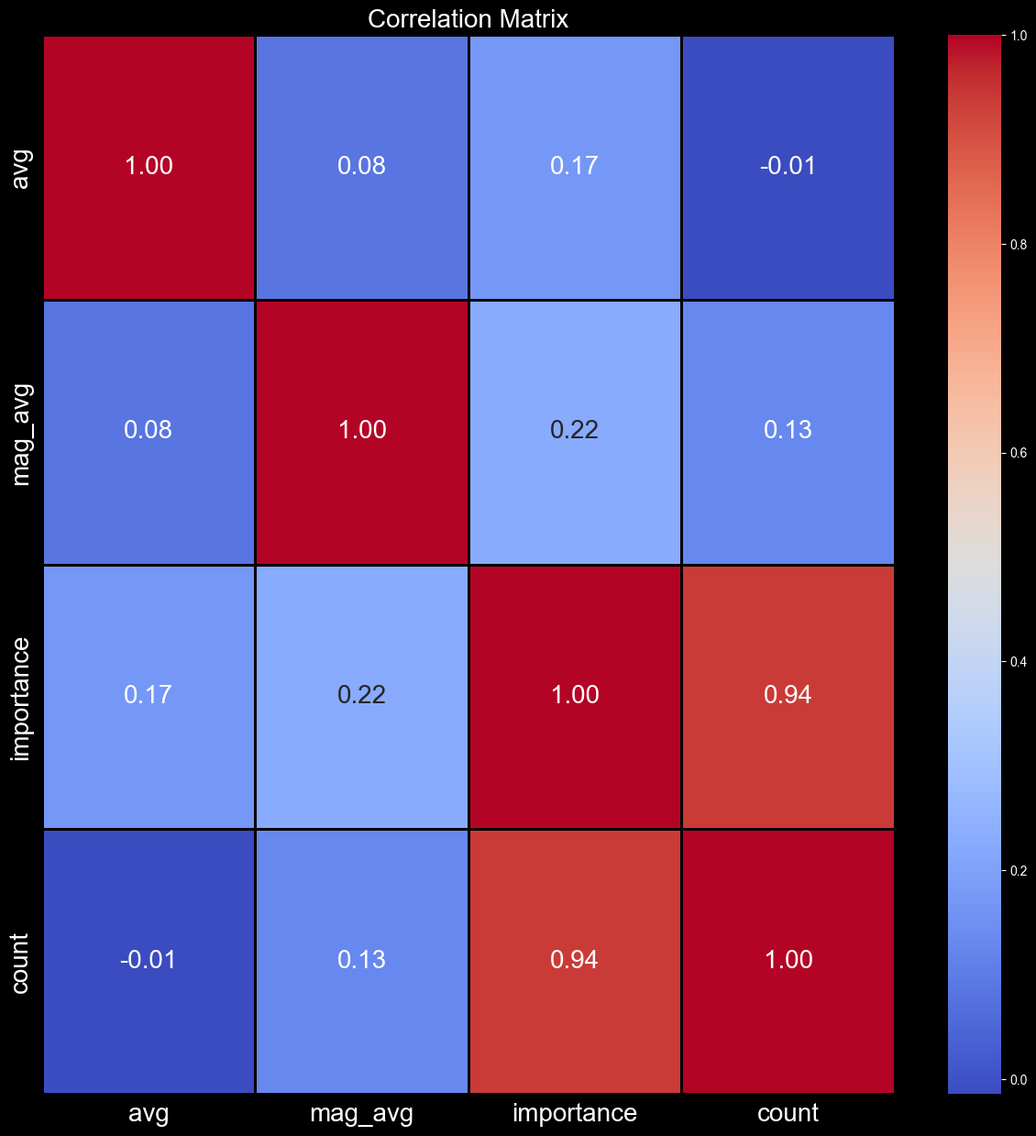
Relationship between the population density and earthquake frequency While there is a very high correlation between count and importance, there is also a positive correlation between importance and average magnitude, which is to be expected given the relationship between the two factors.

Slide 28
Conclusion and Future Work
1-) What is the relationship between the frequency of earthquakes and the population density of a region? The frequency of earthquakes is not directly related to the population density of a region. However, the population density of a region can be affected by the frequency of earthquakes with the following factors:
Higher population density usually means more buildings and infrastructure, which can increase the potential for damage and loss of life in the event of an earthquake.
Areas with high population density may also be more vulnerable to secondary hazards such as landslides (heyelan) or liquefaction (sıvılaşma) which can be triggered by seismic events.
High population density can also make evacuation and emergency response more challenging in the event of an earthquake, which can increase the overall impact of the disaster.

Slide 29
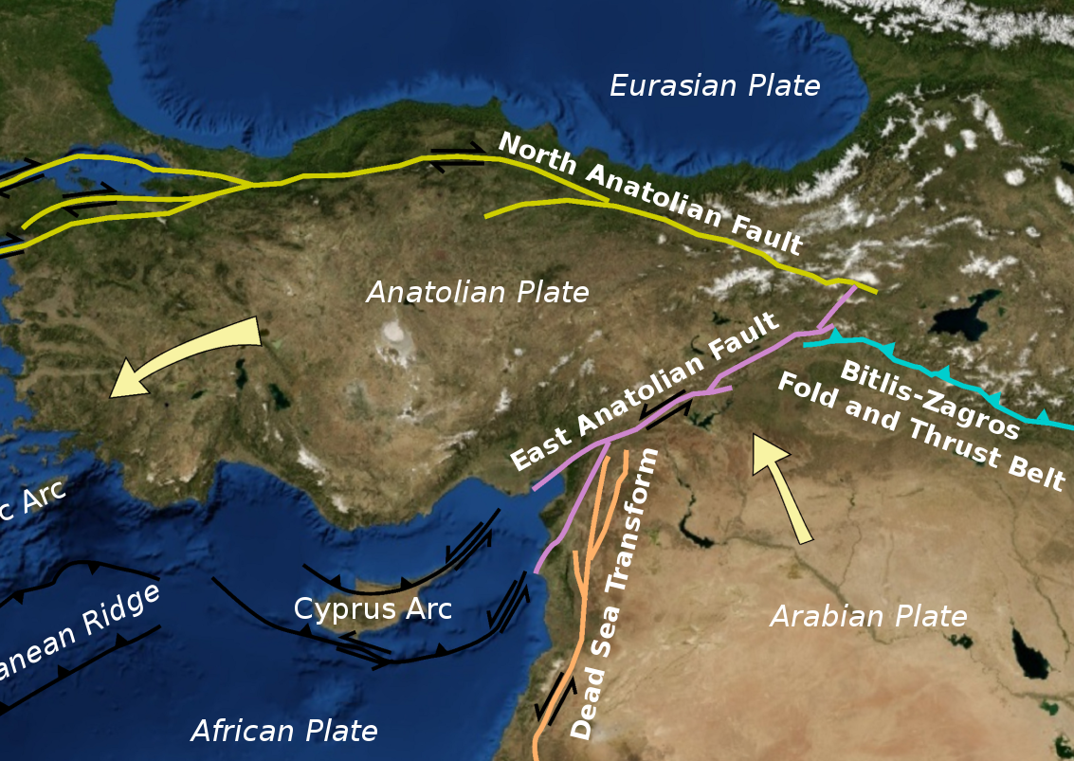
2-) The spatial distribution of seismic risk: Are there certain regions in Turkey that are more at risk than others? What are the factors that contribute to the spatial distribution of seismic risk?
There are certain regions in Turkey that are more at risk than others, such as the Aegean and Marmara regions. The factors that contribute to the spatial distribution of seismic risk include the location and depth of the fault lines, the tectonic activity in the region, and the geological characteristics of the area. The urbanization and population growth in these regions have also increased the exposure and vulnerability to seismic events. Furthermore, the inadequate building codes (yapım kuralları) and construction standards in some areas have increased the risk of damage and casualties.

Slide 30
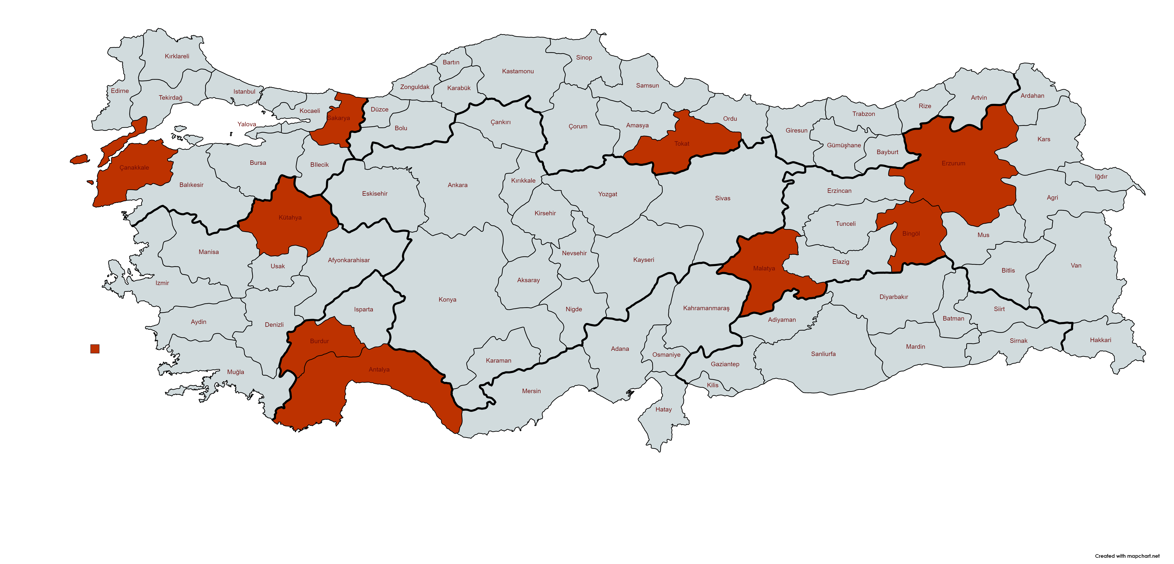
3-) The impact of earthquake magnitude: How does the magnitude of an earthquake affect the seismic risk for a town? Are there certain towns that are more vulnerable to large earthquakes?
The magnitude of an earthquake can significantly affect the seismic risk for a town. Larger earthquakes can cause more damage and casualties, especially if the buildings are not constructed to withstand the seismic forces. Certain towns in Turkey are more vulnerable to large earthquakes due to their proximity to active fault lines, such as the towns located along the North and East Fault Zones.
📌 Çan - Çanakkale
📌 Yeşilova - Burdur
📌 Gediz - Kütahya
📌 Doğanşehir - Malatya
📌 Orta - Tokat
📌 Pütürge - Malatya
📌 Çat - Erzurum
📌 Karlıova - Bingöl
📌 Akyazı - Sakarya
📌 Kaş - Antalya

Slide 31
4-) The effectiveness of earthquake preparedness and response measures: What are the existing earthquake preparedness and response measures in Turkey? How effective are these measures in reducing the impact of seismic events?
Turkey has implemented several earthquake preparedness and response measures, including seismic hazard mapping, earthquake drills (tatbikat), and emergency response plans. However, the effectiveness of these measures in reducing the impact of seismic events depends on their implementation and enforcement. There have been instances of inadequate building codes and construction standards, as well as insufficient emergency response measures, which have led to increased damage and casualties during earthquakes. Therefore, there is a need for continuous improvement and updating of earthquake preparedness and response measures to reduce the impact of seismic events in Turkey.

Slide 32
Q & A Thank you
Başak Dilara Çevik
basakdilaracevik@hotmail.com
https://www.badice.com.tr/

